Slide 1
30 Years of BGP
Design Expectations vs. Deployment Reality in Protocol Development
Geoff Huston
APNIC
June 2019

Slide 2
In the Beginning…
BGP was an evolution of the earlier EGP protocol (developed in 1982 by Eric Rosen and Dave Mills)
BGP-1 – RFC 1105, June 1989, Kirk Lougheed, Yakov Rekhter
  TCP-based message exchange protocol, based on distance vector routing algorithm with explicit path attributes
BGP-3 – RFC1267, October 1991, Kirk Lougheed, Yakov Rekhter
  Essentially a clarification and minor tweaks to the basic concepts used in BGP
BGP-4 – RFC 1654, July 1994, Yakov Rekhter, Tony Li
  Added CIDR (explicit prefix lengths) and proxy aggregation

Slide 3
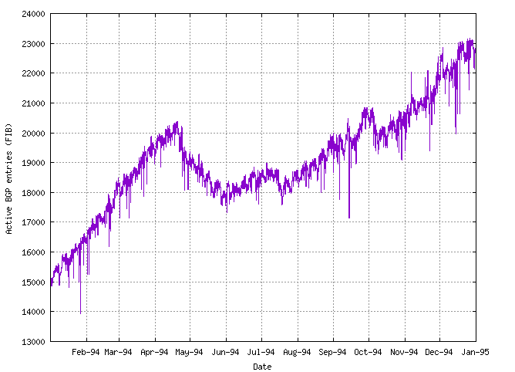
Containing the Routing “Explosion”
IETF ROAD Efforts in 1992 (RFC1380)
  Predicted exhaustion of IPv4 addresses and scaling explosion of inter-domain routing
The chosen “solution” was to drop the concept of address classes from BGP
It (sort of) worked

Slide 4
Containing the Routing “Explosion”
IETF ROAD Efforts in 1992 (RFC1380)
  Predicted exhaustion of IPv4 addresses and scaling explosion of inter-domain routing
The chosen “solution” was to drop the concept of address classes from BGP
It (sort of) worked

Slide 5
IPv6 and BGP
While the IETF adopted the IPv6 address architecture for the address exhaustion issue, it was unable to find an IPv6 routing architecture that had similar scaling properties
  IETF efforts to impose a routing hierarchy (TLAs and sub-TLAs – RFC 2928) got nowhere!
So we just used BGP for IPv6 in the same way as we used BGP for IPv4
  Address allocation policies that allocated ‘independent’ address blocks of /35 or larger
  ISP traffic engineering and hijack “defence” by advertising /48s

Slide 6
BGP isn’t perfect
Session insecurity
Payload insecurity
Protocol instability
Sparseness of signalling
No ability to distinguish between topology maintenance and policy negotiation

Slide 7
Scale generates inertia
BGP-4 was introduces when the routing table contains ~ 20K entries – it is now ~800K entries
The network carries some 75K ASNs
Changing the internet to use a new common IDR protocol would be incredibly challenging – something would need to break to force change

Slide 8
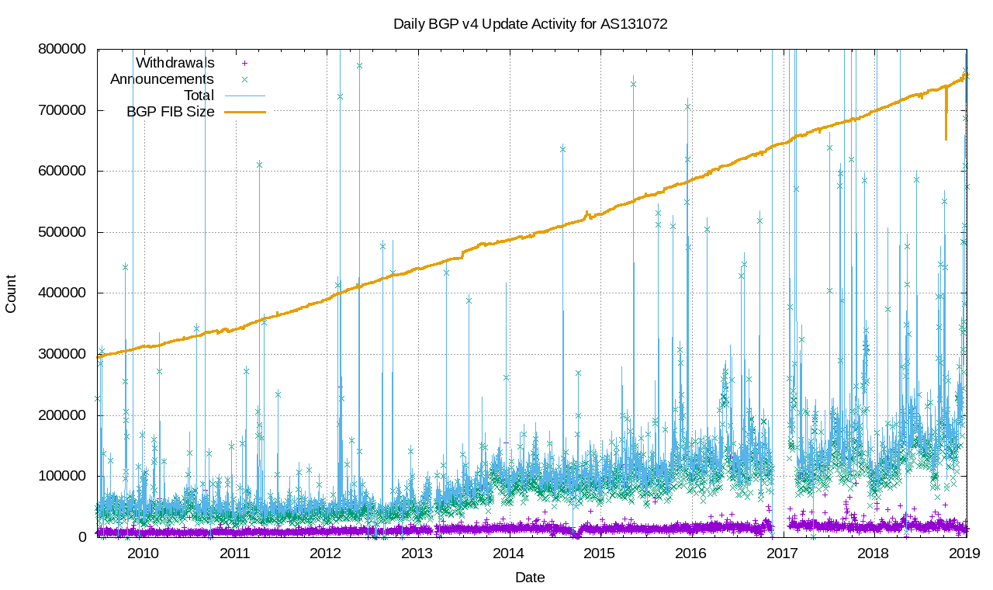
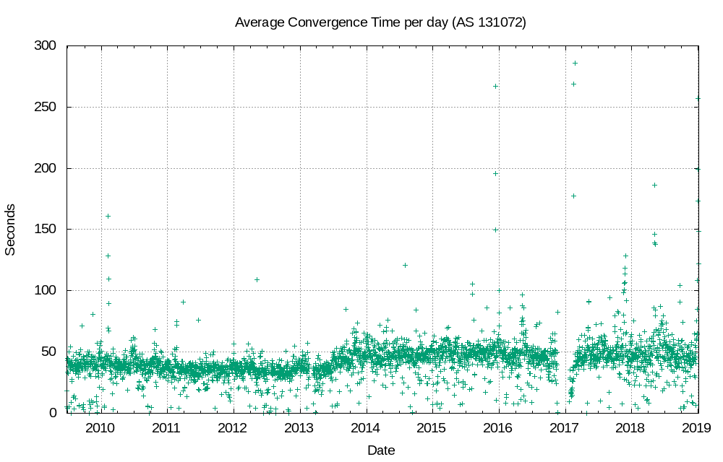
BGP Scaling
BGP has scaled because the protocol only passes changes
As long as the change rate is low the BGP load is low
And the inter-AS topology of the Internet works in BGP’s favor
And this has allowed BGP to grow well beyond the original design expectations

Slide 9
Expectations vs Deployment
Session lifetime
  Expectations of short session lifetimes – experience of longevity
Session Security
  Expectation of routing being a public function - experience of session attack
Payload Integrity
  Expectations of mutual trust – experience of malicious and negligent attack
Protocol Performance
  Expectations of slow performance – experience of more demanding environments
Error Handling
  Expectations of “clear session” as the universal solution – experience required better recovery without session teardown
Use
  Expectations of topology maintenance – experience of traffic engineering

Slide 10
Why does BGP still work?
It’s a Hop-by-Hop protocol
  This allows new behaviours to be deployed on an incremental basis, as long as there is a “tunnelling” capability to pass through legacy speakers
    A classic example is the 2-byte to 4-byte AS number transition in BGP
It’s layered above a generic reliable stream transport
  Arbitrary message sizes are supportable
  No need to refresh sent information

